Slide 1
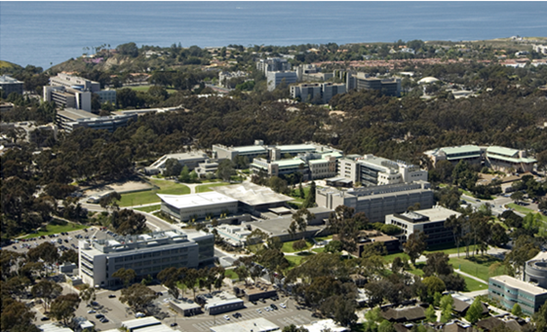
University of California San Diego Pediatric Hospital Medicine Fellowship
at Rady Children’s Hospital San Diego
Notes:
Welcome.
I’m (name), and I’m the (title).
I oversee (blank) departments, and I’ve worked for UCSD for (blank) years.
I’m delighted to have this opportunity to share with you an overview of UC San Diego’s Health Sciences.

Slide 2
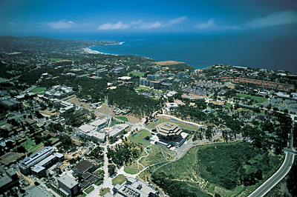
University of California, San Diego
Nationally ranked as the 9th best public university (U.S. News & World Report, 2010 America’s Best Colleges)
Dedicated to the advancement of knowledge through excellence in education and research
6 undergraduate colleges, 7 professional schools
Notes:
Health Sciences if part of the University of California, San Diego.
UC San Diego is a top-ranked university that is dedicated to learning, teaching, and serving society through education, research and public service.
Its academic excellence is built on a strong faculty and an innovative educational approach that includes interdisciplinary programs which expand traditional boundaries.
Instead of being organized around a field of study, each of the six colleges focus on a distinct philosophy and core learning courses.

Slide 3
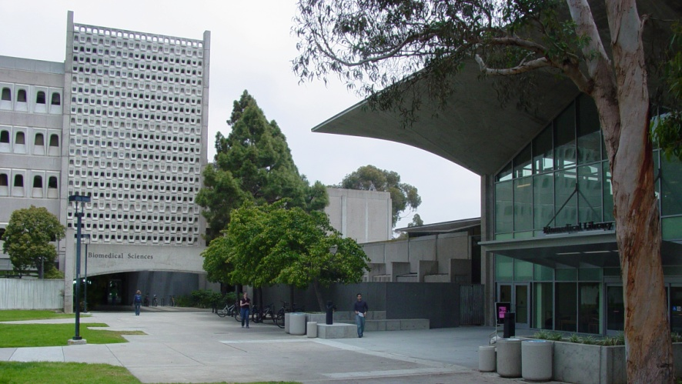
UC San Diego Health Sciences
Worldwide reputation for excellence and innovation
Proven track record in scientific breakthroughs
Health Sciences includes:
School of Medicine
Skaggs School of Pharmacy and Pharmaceutical Sciences
UC San Diego Medical Group
UC San Diego Medical Center
Notes:
In only four decades, Health Sciences has achieved national and international distinction as a premier institution, renowned for biomedical research, education and clinical care.
Health Sciences programs are known for having physicians and scientists working together, across disciplines, to deliver meaningful breakthroughs.
The School of Medicine and Skaggs School of Pharmacy are dedicated to cultivating and supporting future practitioners.
While the Medical Group and Medical Center, our hospitals, clinics and specialized centers are organized to bring innovation to the front lines of patient care.

Slide 4
UCSD PHM Fellowship at Rady Children’s
Overview
Core Curriculum
Clinical Training
Quality Improvement and Patient Safety
Education
Research
ABC Lead: Admin, Business, Career development, Leadership

Slide 5
The Two Year Schedule
UCSD PHM Fellowship
CLINICAL ( C) [Direct supervision unless noted*] | Location | Block or longitudinal | Educ. Units | Detail | F1 weeks | F2 weeks | TOTAL weeks | % for fellowship (of 104 weeks)
Main Ward: includes tertiary and quaternary care | Rady Children's Main Campus | Longitudinal | 6.5 | Full spectrum; subspecialty and complex care; all ages | 12 | 12 | 24 | 23%
Newborn and neonatal ICU (at community site^) | Palomar Medical Center | Block | 0.5 | Community; newborns | 0 | 2 | 2 | 2%
Critical Care : includes, OR, PICU, Transport, Sedation | Rady Children's Main Campus and for Transport, to varied referring site locations | Block | 0.5 | Full spectrum; subspecialty and complex care; all ages | 2 | 0 | 2 | 2%
Community site ward^ | Grossmont Hospital | Block | 0.5 | Community; all ages | 2 | 2 | 4 | 4%
TOTAL CLINICAL |  |  | 8 |  | 16 | 16 | 32 | 31%
INDIVIDUALIZED CURRICULUM (Includes clinical and non-clinical experiences) |  |  | Units | Detail | F1 weeks | F2 weeks | TOTAL weeks | % for fellowship (of 104 weeks)
Core Curriculum | Rady Children's Main Campus | Block | 1 | Core Competencies, clinical and non-clinical | 4 | 0 | 4 | 4%
Quality and Safety (Includes individualized project) | Rady Children's Main Campus | Longitudinal | 3.5 | Systems, Scholarship | 6 | 8 | 14 | 13%
Education | Rady Children's Main Campus | Longitudinal | 1 | Teaching; Curriculum; Presentations | 2 | 2 | 4 | 4%
"ABC lead" : Adminstrative, Business, Career Development, Leadership | Rady Children's Main Campus | Block | 0.5 | Systems, Scholarship | 0 | 2 | 2 | 2%
Complex Care and Transitional Medicine# | Rady Children's Main Campus | Block | 1 | Systems, Clinical and non-clinical | 4 | 0 | 4 | 2%
Electives+ | Existing approved sites | Block | 1 | Varied | 0 | 4 | 4 | 2%
TOTAL |  |  | 8 |  | 16 | 16 | 32 | 31%
SCHOLARSHIP (RESEARCH) |  |  | Units | Detail | F1 weeks | F2 weeks | TOTAL weeks | % for fellowship (of 104 weeks)
Research (Training and project) | Rady Children's Main Campus | Longitudinal | 8 | SCHOL | 16 | 16 | 32 | 31%
TOTAL |  |  | 8 | SCHOL | 16 | 16 | 32 | 31%
Vacation |  |  | 2 |  | 4 | 4 | 8 | 8%
TOTAL |  |  | 26 |  |  |  |  | 100%
1 unit equals 4 weeks; 48 weeks annually (12 units/yr); 24 units/2 yrs
Notes:
The Shiley Eye Center, also in La Jolla, is renowned for its research and eyesight-saving treatments and surgeries. Patients travel here from different parts of the country and world to seek treatment.
The Center for the Future of Surgery, a project of the Surgery Research Laboratory, charges us with its mission to test surgical tools, techniques and teaching methods.
The Center is working with medical device manufacturers and the recently established Institute of Engineering in Medicine at UC San Diego to develop instruments and cameras that offer patients the most advanced and precise care possible. These studies will investigate how surgeons can best be equipped with the tools, knowledge and experience to provide safe, state-of-the-art surgery for their patients.
The emphasis is on minimally invasive techniques and laparascopic and robotic technologies that result in less scarring and faster recovery for the patient. This includes NOTES, which involves passing surgical instruments, and a tiny camera, through a natural orifice, such as the mouth or the vagina, to the desired organ. By avoiding major incisions through the skin, muscle, and nerves of the abdomen, patients may experience a quicker recovery with less pain and scarring while reducing the risk of post operative hernias.
When it opens in 2010, the Sulpizio Family Cardiovascular Center will expand the Thornton Hospital emergency room and add intensive care beds, operating rooms and procedure areas to the La Jolla medical campus. There, patients will have one central hub of research and clinical care where they can access the most advanced diagnostic techniques, clinical trials and clinical care – both inpatient and outpatient – for all types of cardiovascular diseases.

Slide 6
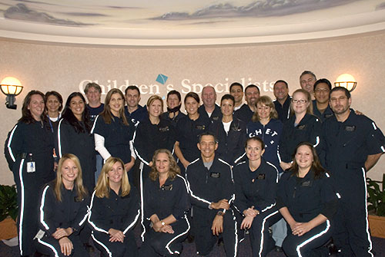
UCSD PHM Fellowship at Rady Children’s
Clinical Training
Admissions and Consultations
Teaching Service at Tertiary Site
Medical students, residents, nurse practitioners
Telehealth in Special Infectious Diseases Unit, and for teaching
Children’s Hospital Emergency Transport
Serving as Medical Control Officer
Participation on Transports
Pediatric Critical Care
Procedure Skills
Real World
Simulation
POCUS
Certification in Moderate Sedation
Community Site Experiences:
Sharp Grossmont Hospital (rotation)
Palomar Medical Center (newborn and NICU)

Slide 7
UCSD PHM Fellowship at Rady Children’s Complex Care and Transitional Medicine
2 week rotation
Unique training at skilled, subacute and homecare settings, with telehealth options
Individualized curriculum (additional 2 week rotation):
Palliative Care, with telehealth options
Physical Medicine and Rehabilitation
Genomics
Experiences:
Homecare visits
Procedures
Consults
Notes:
The Medical Center includes two hospitals in two different locations and has the following combined statistics for fiscal year 2009.
(Go through and highlight key data points)

Slide 8
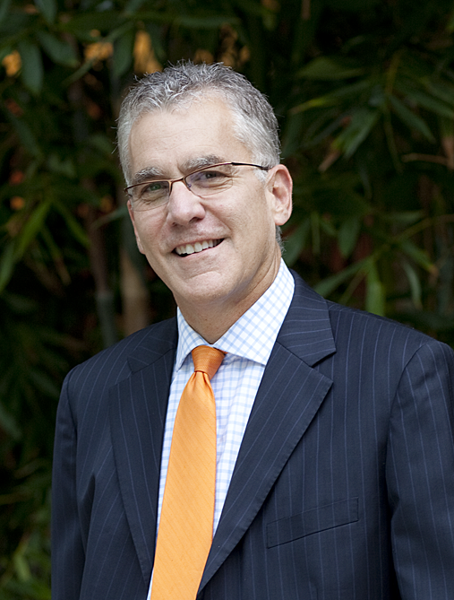
UCSD PHM Fellowship at Rady Children’s Quality Improvement and Patient Safety
2 year longitudinal curriculum
F1 Quality and Safety Curriculum
F2 Quality Curriculum
QI and Risk Management Committees
Pathways and Algorithms
QI longitudinal project
QI scholarly work
Divisional Joint PHM-PEM QI Collaborative Participation
Notes:
The Medical Group is a multi-specialty group comprised of about 700 faculty members that practice at the Medical Center and is led by Dr. Tom McAfee.
Dr. McAfee provides leadership for inpatient and outpatient physician practice and for the advancement of our clinical enterprise vision and ensures that UCSD's clinical practice is achieving the highest standards of service, quality, safety, compliance and overall performance.
He also helps to assure that our clinical programs and activities are integrated with and support the clinical, research, educational and community outreach missions of the Health Sciences.

Slide 9
UCSD PHM Fellowship at Rady Children’s Education
2-year longitudinal curriculum taught by MEd faculty
Topics include:
Adult Learning Theory
Bedside and Multimodal Teaching
Giving and Receiving Feedback
Curriculum Development
Assessment and Evaluation
Study Design and Research Methods
Psychology of Behavior and Attitude Formation
Ways to Incorporate Technology in Teaching
Maintaining CV and Educator Portfolio
Manuscript Peer Review
Manuscript Writing
Teaching and Learning Opportunities:
Teaching on Clinical Service to Students and Residents
Presenting at Resident Noon Conference or Other Educational Venues
Presenting annually at PHM Journal Club
Peer Teaching to Junior Fellows
Precepting at UCSD School of Medicine sessions
UCSD Medical Education Grand Rounds
Notes:
As San Diego’s only university-based health system, the UC San Diego Medical Center delivers the newest diagnostic technologies and treatments to patients, with education and discovery driving advances in preventing, managing and curing disease and injury.
The Medical Center includes two hospitals in two different locations, with a combined capacity of 548 beds.
It has been able to build on UC San Diego’s extraordinary research strengths to enhance clinical care and is striving to achieve the same world-class reputation for its clinical programs that the Health Sciences’ research and academic missions have attained.
By having higher-profile clinical programs, we will have more research collaborations with biotech and pharmaceutical companies and increased visibility and funding to support our programs.
Our clinical strategic plan is designed to reach this achievement through our new vision of Clinical Excellence…Through Service, Innovation and Education.
We also have plans for growth at both hospitals. A new 125-bed inpatient tower on the La Jolla campus is slated for opening in 2015 and more than $80 million in enhancements to the Hillcrest location are almost complete – and we will continue to invest $10 million annually to this facility.

Slide 10
UCSD PHM Fellowship at Rady Children’s Research
2 year longitudinal rotation taught by MSc, MA, PhD faculty
Core training F1 year (16 core topics)
Monthly Fellows Research Workgroup Sessions
Didactics; peer feedback on research
UCSD Pediatric Fellows Research Seminar Series
Core research didactic; presentation experience
Children’s Hospital Association Health Services Research online modules
Option for formal clinical research training through UCSD CREST program:
Patient-Oriented Research, Basic Epidemiology, Health Services Research integrated into first year
Optional second year CREST
MPH or MAS (requires 3 yrs; please ask for details)
Individualized training such as qualitative software skills, geo-mapping, informatics certificates related to scholarly work
Scholarly work submitted to national meetings
Notes:
In addition to our two hospitals, the Medical Center also consists of specialty centers located in La Jolla.
These centers include the Moores UCSD Cancer Center, a National Cancer Institute Comprehensive Cancer Center – the highest designation a cancer center can achieve in terms of research, clinical care and community outreach. We are the only hospital in San Diego to have this designation.
The Cancer Center is where nearly 300 medical and radiation oncologists, surgeons and researches work together to develop the next generation of life-saving therapies and technology. It offers an innovative program to address the psychological and social dimensions of cancer treatment, showcased in 2008 in an Institute of Medicine report as a model for the nation.
Its extraordinary research base and collaborative patient care environment make the Cancer Center a leader for cutting-edge cancer care and investigational therapies.
The Cancer Center is also participating in an unprecedented statewide University of California collaboration to improve care for breast cancer patients by designing and testing new approaches to research, technology and health care delivery. Named the ATHENA Breast Health Network, the project will initially involve 150,000 women throughout California who will be screened for breast cancer and followed for decades through the five UC medical centers.
The Medical Center’s Radiation Oncology Department has also opened additional facilities in the South Bay and in North County to offer patients who need radiation therapy greater convenience.
The Cancer Center is also the location of a National Cancer Institute (NCI) Center for Cancer Nanotechnology Excellence. The mission of the center is to fight cancer by using nanotechnology to develop anti-cancer therapies that directly target tumor cells and to have more accurate and faster diagnostics and ways to track down cancer cells that survive therapy.

Slide 11
UCSD PHM Fellowship at Rady Children’s ABC Lead: Admin, Business, Career development, Leadership
F2 year curriculum (rotation)
Didactics and Experiences:
Business practices
Risk management, peer review, medical staff
Leadership conferences
Professionalism in practice
Team leadership
Career mentorship
Notes:
To develop world-class programs, you have to have more than a vision. You need to know where you’re going, build a strong team and have systems.
The Senior Executive Leadership team within the Medical Center has committed to meeting aggressive strategic plan goals that were established to support and advance people, service, quality, innovation, growth and financial success.
(Briefly mention by name who oversees what).

Slide 12
UCSD PHM Fellowship at Rady Children’s Advocacy
Experiences
Juvenile Hall
Palliative Care
AAP
California Specialty Care Coalition
Home Care
Option for Advocacy focus for QI or research
Notes:
The Medical Center includes two hospitals in two different locations and has the following combined statistics for fiscal year 2009.
(Go through and highlight key data points)

Slide 13
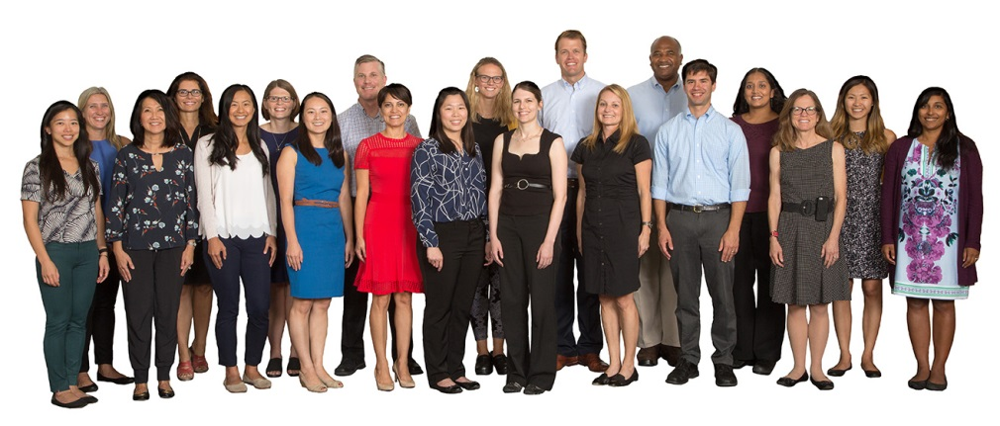
UCSD PHM Fellowship at Rady Children’s
Strong Leaders and Mentors
Directorships
Medical Director of Juvenile Hall System
Medical Director of Hospital Pediatric Palliative Care
Medical Director for Quality and Patient Safety
Medical Director of Graduate Medical Education
Medical Director of Children’s Home Care
Medical Director, Bernardy Center Subacute and Skilled Nursing Facility
Director of Inpatient Services at RCHSD
Medical Director, Pediatric Unit, Sharp Grossmont Hospital
Co-Director of Children’s Emergency Transport Services
Medical Director, Consult service to Child and Adolescent Psychiatric Unit
Medical Director, Simulation
Advanced Degrees and Other Experience
Masters in Medical Education
Master of Arts and Masters of Science
Masters of Public Health
PhD Engineering Design, Healthcare
Board Certification in Hospice and Palliative Care
Clinical Dermatology Fellowship
Ethics formal training
Palliative Care formal training
Board Certification in Pediatric Critical Care
Society for Pediatric Sedation faculty
Senior Fellow in Hospital Medicine
Master in Hospital Medicine
Clinical Informatics certifications
2 of the 4 physician informaticists are in PHM!
Notes:
Health Sciences is led by Vice Chancellor Dr. David Brenner.
In his role, he oversees the School of Medicine, Skaggs School of Pharmacy, the Medical Center and the Medical Group.
Within Health Sciences, there are over 900 faculty, 7,500 staff; more than 600 medical and pharmacy students; and a health system that cares for thousands of patients annually.

Slide 14
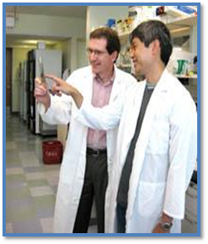
UCSD PHM Fellowship at Rady Children’s Conferences and Collaborations
Fellows also attend multiple conferences for the hospital and the department :
UCSD Pediatric M&M and Rady CHET M&M
UCSD Fellows Research Seminar Series
UCSD Pediatric Grand Rounds
Rady Schwartz Rounds
Rady Interprofessional Symposium
UCSD Pediatrics Research Symposium
Attendance of national conferences
Fellows receive up to $3000 annually for CME, certificates, graduate course work, and other educational expenses
Joint training in ultrasonography with Pediatric Emergency Medicine fellows
Joint Journal Club with Pediatric Critical Care and Emergency Medicine fellows

Slide 15
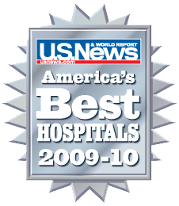
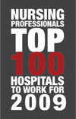
Rady Children’s - National Recognition
Ranked among the nation’s best in 10 specialties (U.S. News & World Report, 2009 America’s Best Hospitals)
Ranked in the “Top 100 Hospitals to Work For” (Nursing Professionals magazine)
Among the nation’s 100 “Most Wired” hospitals for four consecutive years (Hospitals and Health Networks)
One of the 25 “Most Wireless” hospitals for three consecutive years (Hospitals and Health Networks)
Notes:
Our Medical Center has received national recognition by different organizations and has the distinction of being the only top-ranked hospital in San Diego, as evidenced by our recent U.S. News & World Report rankings!
Respiratory Disorders 14th
Psychiatry 20th
Rheumatology 21st
Urology 39th
Kidney Disorders 43rd
Cancer 47th
In 2009, Nursing Professionals Magazine ranked us as one of the “Top 100 Hospitals to Work For,” which is a prestigious designation and quite a testament to our nursing leadership and staff.
The Medical Center has been on both Hospitals and Health Networks’ the “Most Wired” and “Most Wireless” lists multiple times – recognition that putting patients first doesn’t mean technological improvements can’t move forward.

Slide 16
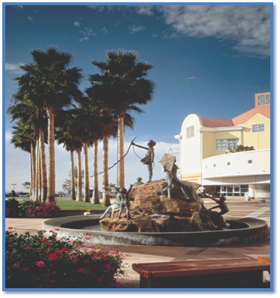
UCSD PHM Fellowship at Rady Children’s
Our fellowship program participates in both ERAS and NRMP.
We are accepting applications for the fellowship which begins on approximately July 7th. Candidates must be BC/BE in pediatrics by the beginning of the fellowship.
Fellowship Director: Dr. Erin Stucky Fisher, MD, MHM
Associate Director: Aarti Patel, MD, MEd
Fellowship Coordinator: Georgina Hernandez For direct inquiries, call (858) 966-5841 or phmfellowship@rchsd.org
For details of our fellowship, https://medschool.ucsd.edu/som/pediatrics/Divisions/HospitalMedicine/education/Pages/fellowship.aspx
Notes:
UC San Diego is where discoveries are delivered, every day.

Slide 17
Thank you!

